Slide 1
Hadoop in Ubuntu
Dr.Preethi Ananthachari
Asst.Professor
Endicott College of International Studies
Woosong University
preethi.ga@wsu.ac.kr

Slide 2
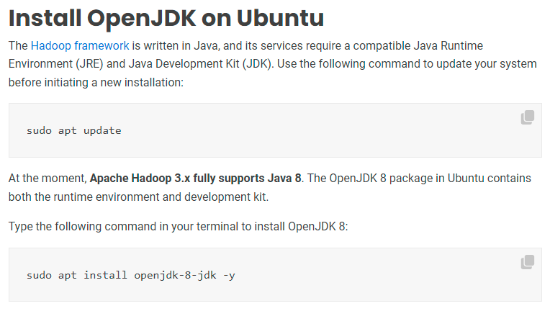
sudo apt install default-jdk

Slide 3
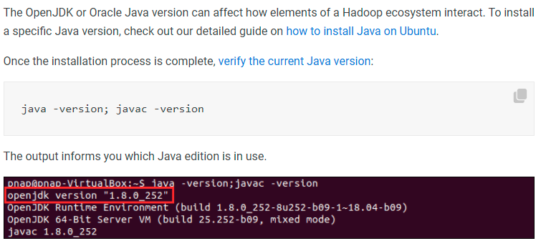

Slide 4
Install Java
Sudo apt-get update
Java –version
Sudo apt-get install openjdk-8-jdk
Sudo apt-get install openjre-8-jre
Sudo update-alternatives –config java
Sudo nano /etc/environment
To know java path, readlink –f /usr/bin/javac
Add the path
Save it
Source /etc/environment

Slide 5
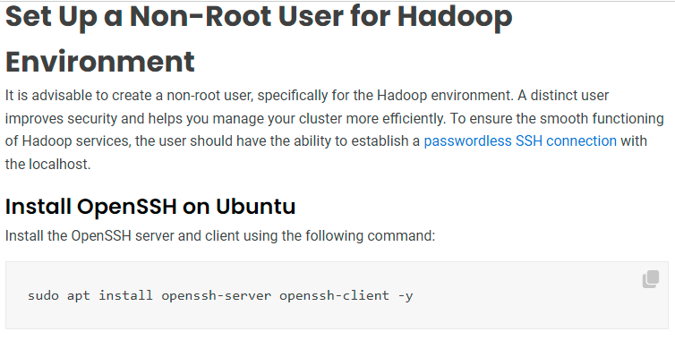
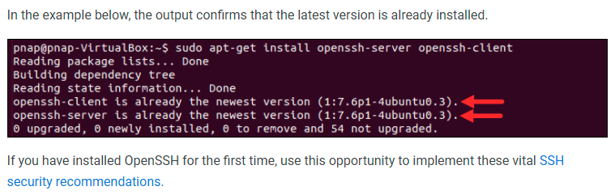
sudo apt-get install ssh

Slide 6

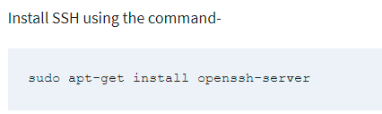
Configure SSH
Sometimes the previous step will not work, in that case,

Slide 7
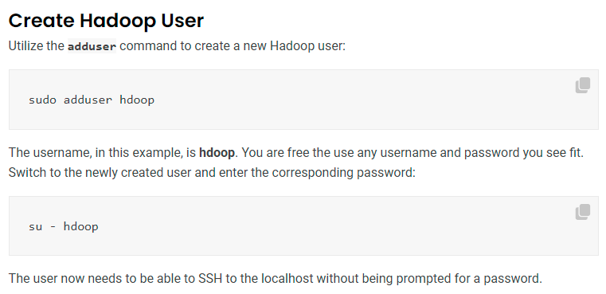
sudo adduser hduser

Slide 8
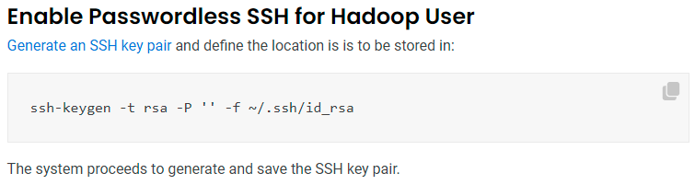
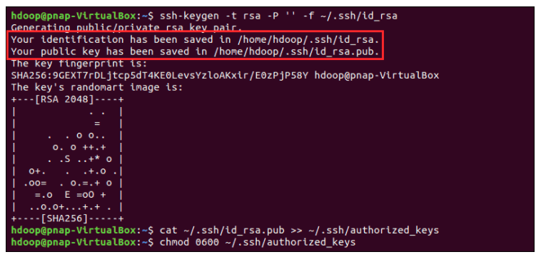

Slide 9
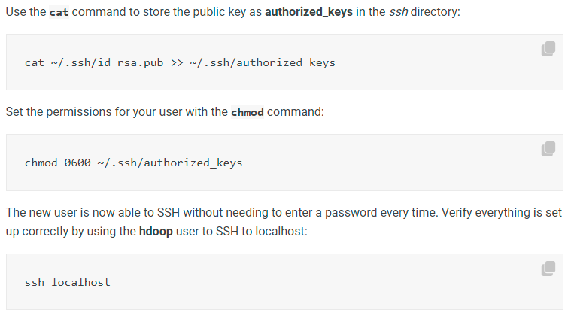

Slide 10
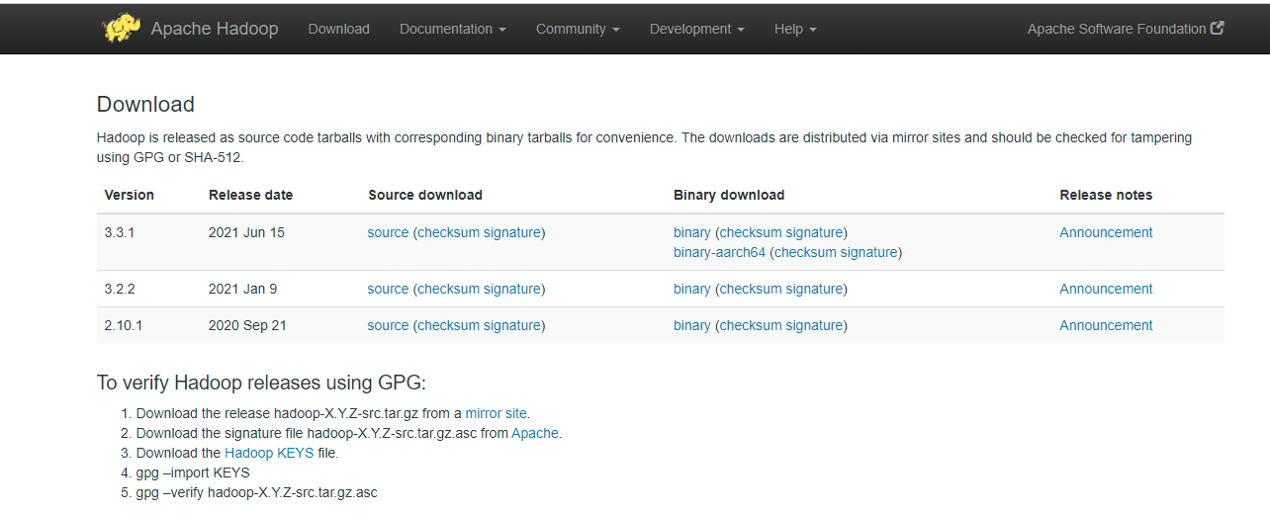
Download and Install Hadoop on Ubuntu
Visit the official Apache Hadoop project page, and select the version of Hadoop you want to implement.

Slide 11
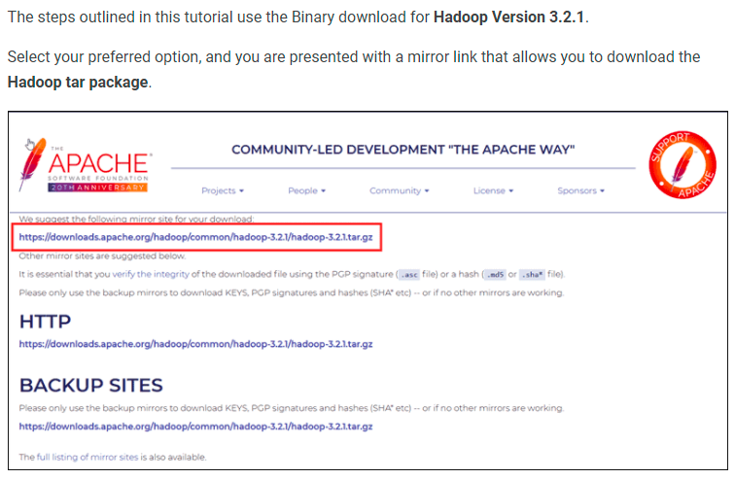

Slide 12
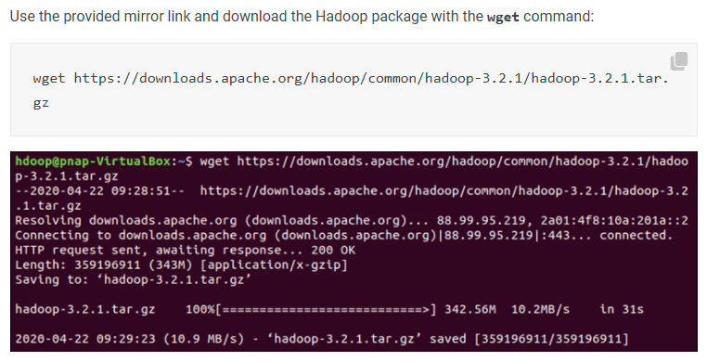

Slide 13
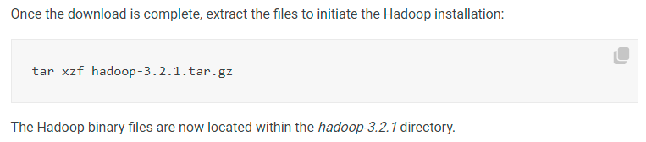
Suppose you download manually, it will be in ‘Downloads’
sudo mv ~/Downloads/hadoop-3.2.2.tar.gz /home/hadoop
Add sudo
sudo ln –s hadoop-3.2.2 hadoop
sudo chown –R hduser:hadoop hadoop-3.2.2
sudo chmod 777 hadoop-3.2.2

Slide 14
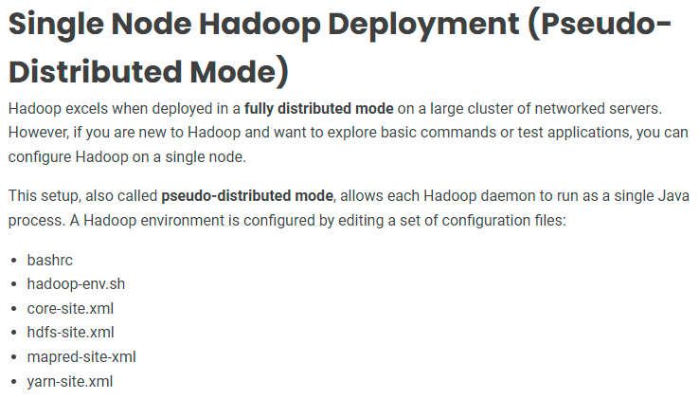

Slide 15
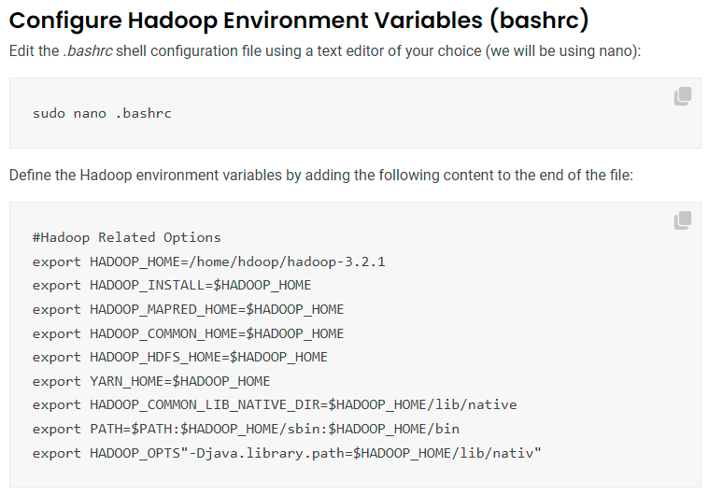

Slide 16
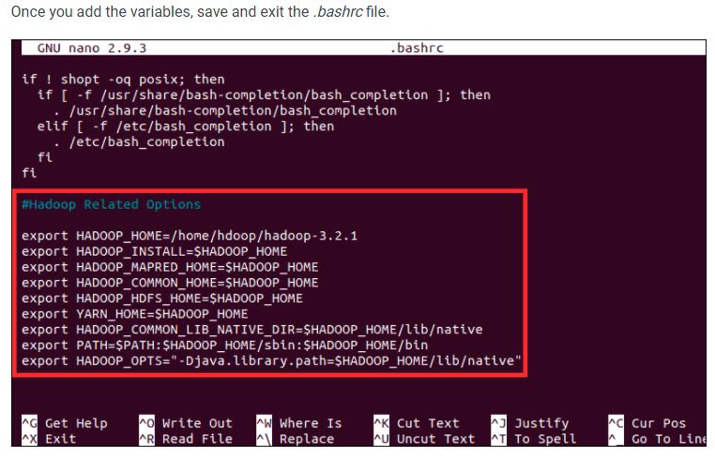

Slide 17
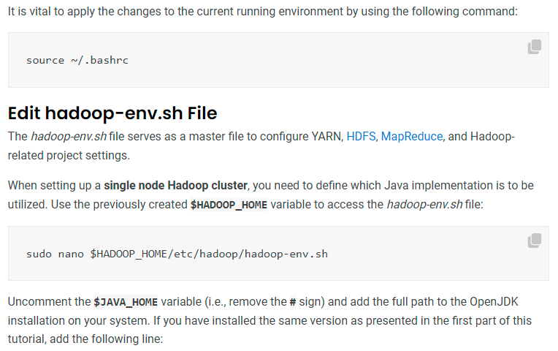

Slide 18
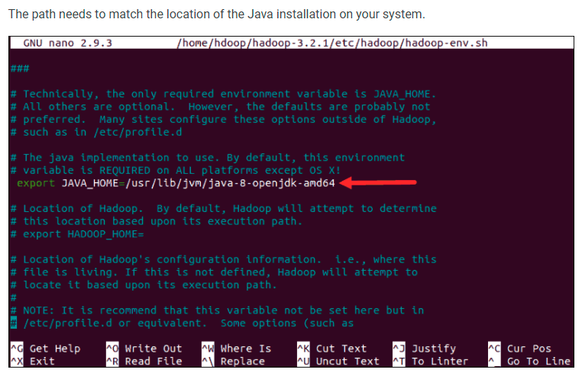

Slide 19
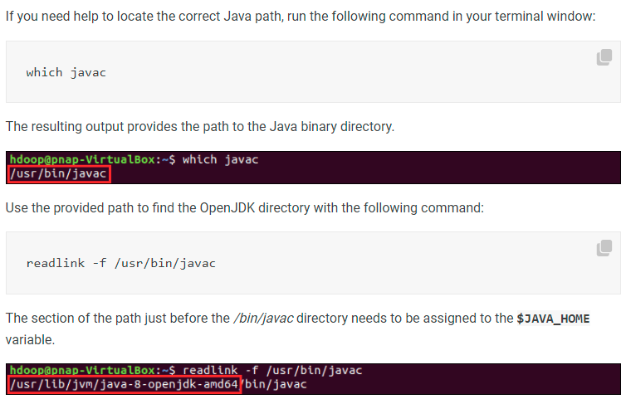

Slide 20
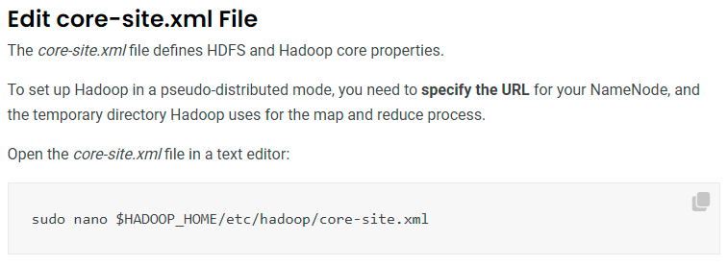

Slide 21
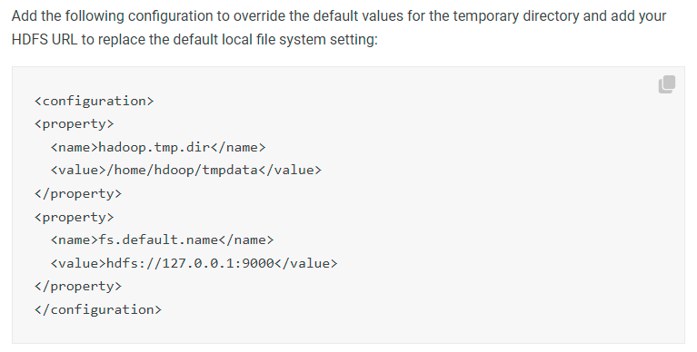
/home/hduser/tmpdata
localhost://127.0.0.1:9000

Slide 22
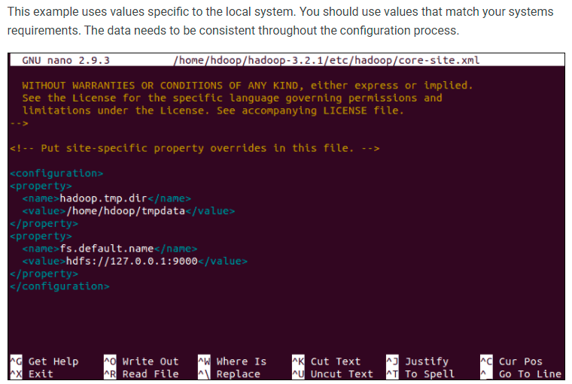

Slide 23
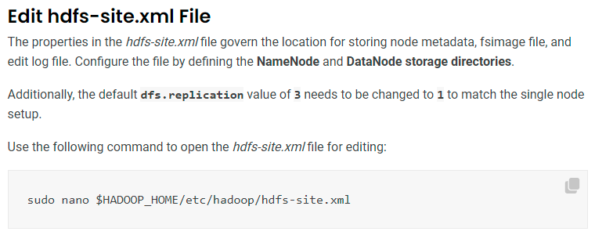

Slide 24
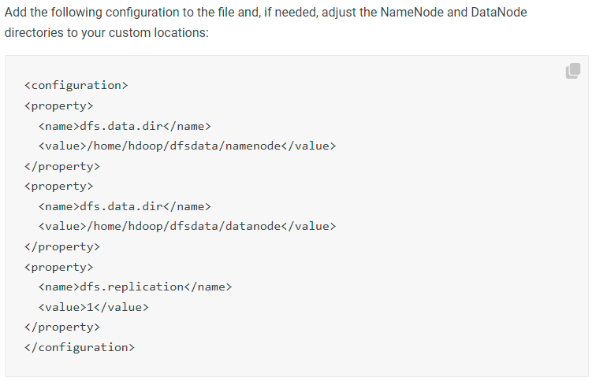
dfs.name.dir
/home/hadoop/dfsdata/namenode
/home/hadoop/dfsdata/datanode

Slide 25
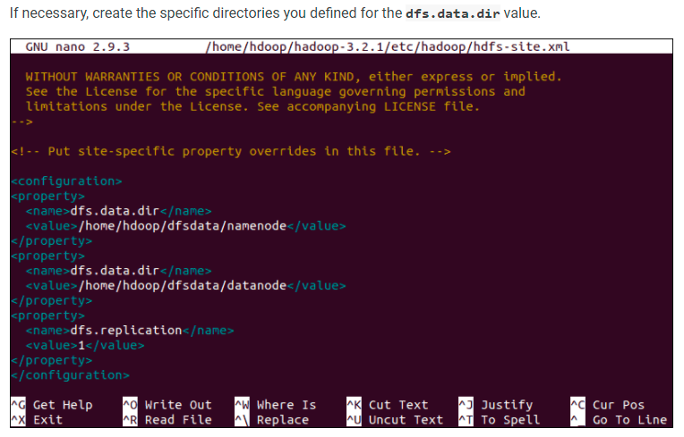

Slide 26
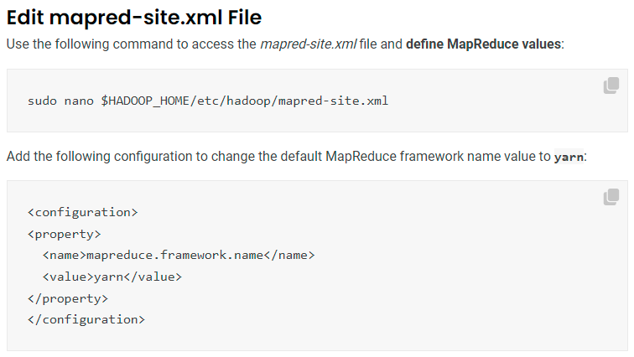

Slide 27
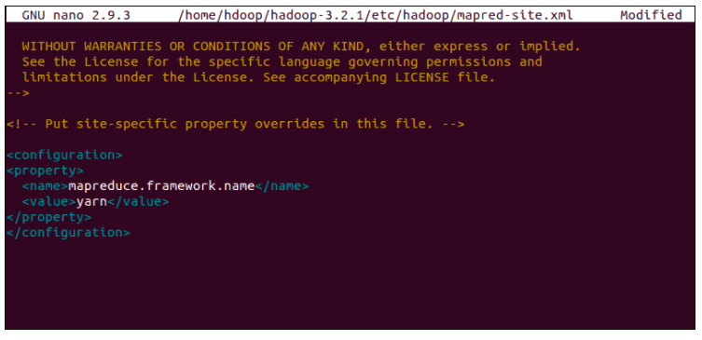

Slide 28
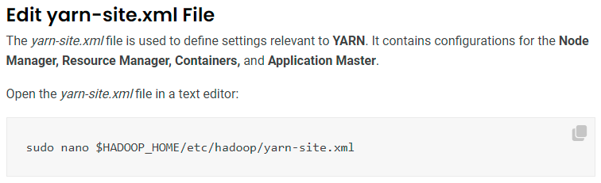
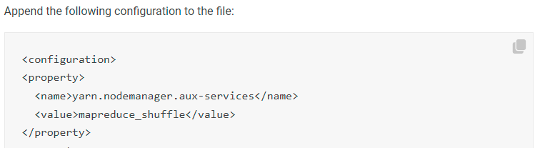

Slide 29
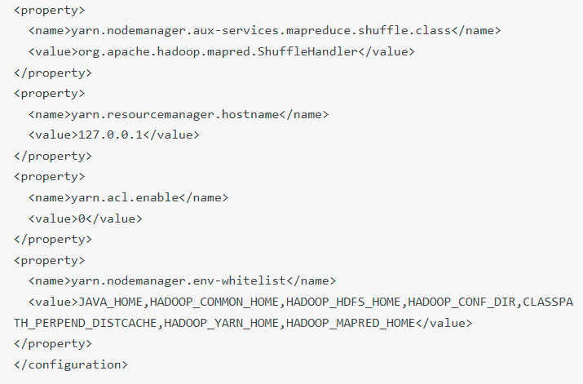

Slide 30
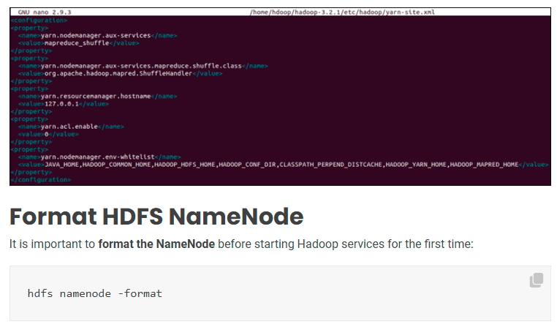

Slide 31
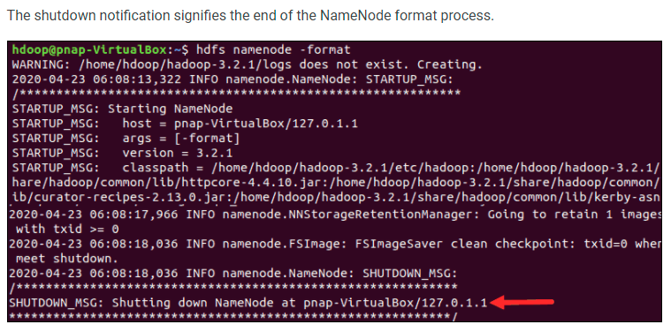

Slide 32
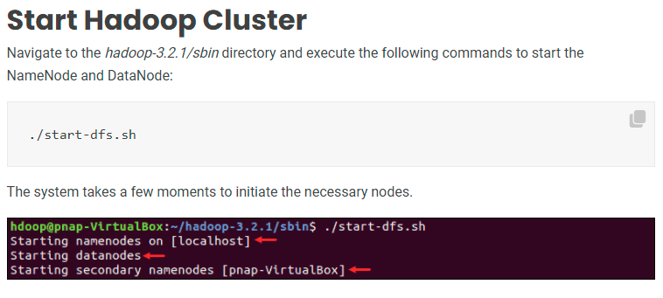

Slide 33
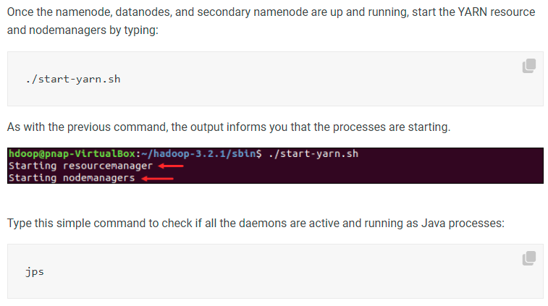

Slide 34
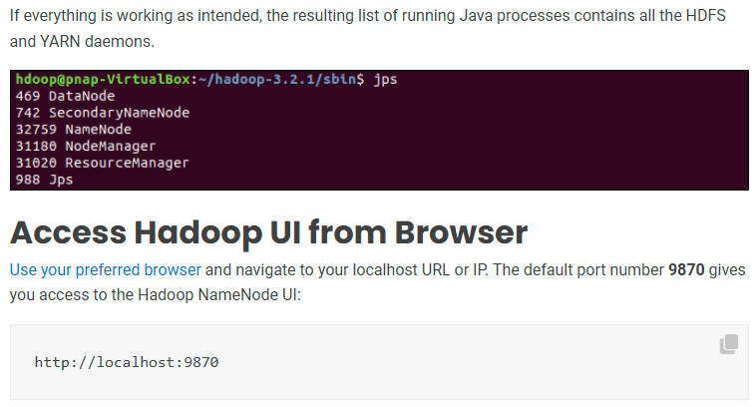

Slide 35
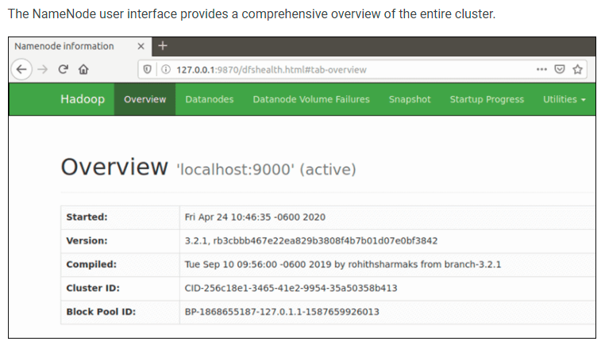

Slide 36
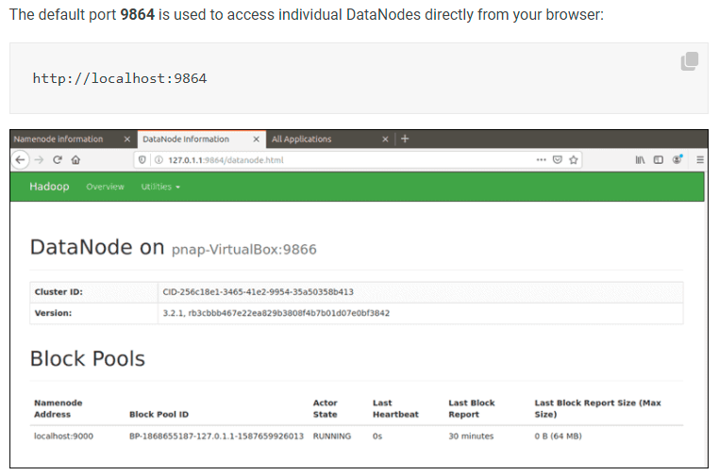

Slide 37
